Slide 1
Methods

Slide 2
Introduction to Methods
Methods can be used to break a complex program into small, manageable pieces
This approach is known as divide and conquer
In general terms, breaking down a program to smaller units of code, such as methods, is known as modularization
Two types of methods are:
A void method simply executes a group of statements and then terminates
A value-returning method returns a value to the statement that called it

Slide 3
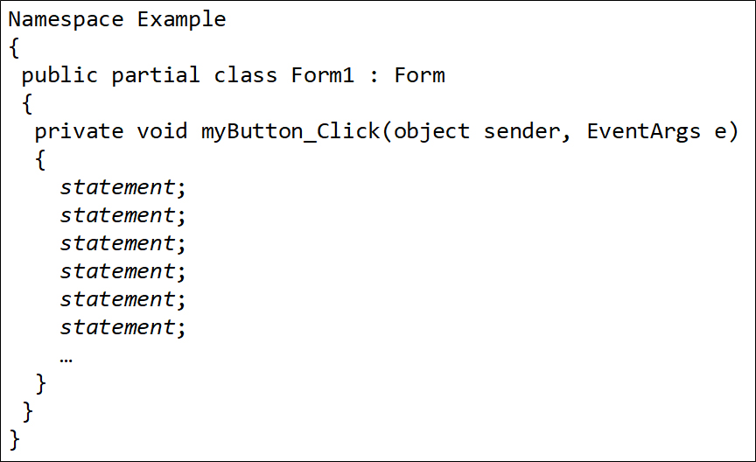
Example (1 of 2)
Using one long sequence of statements to perform a task

Slide 4
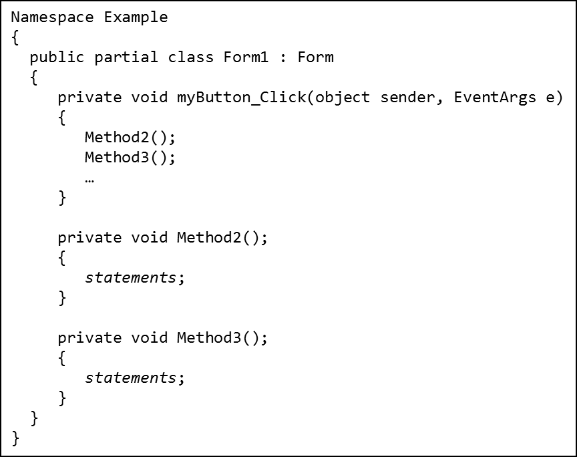
Example (2 of 2)
Using methods to divide and conquer a problem

Slide 5
void Methods
A void method simply executes the statement it contains and then terminates. It does not return any value to the statement that called it.
To create a method, you write its definition
A method definition has two parts:
header: the method header appears at the beginning of a method definition to indicate the access mode, return type, and method name
body: the method body is a collection of statements that are performed when the method is executed

Slide 6
The Method Header (1 of 2)
The book separates a method header into four parts :
Access modifier: keyword that defines the access control
private: a private method can be called only by code inside the same class as the method
public: a public method can be called by code that is outside the class.
Return type: specifies whether or not a method returns a value
Method name: the identifier of the method; must be unique in a given program. This book uses Pascal case (aka camelCase)
Parentheses: A method's name is always followed by a pair of parentheses

Slide 7
The Method Header (2 of 2)
Access
Modifier
Return
Type
Method
Name
Parentheses
private void DisplayMessage()
{
MessageBox.Show("This is the DisplayMessage method.");
}

Slide 8
Declaring Method Inside a Class (1 of 2)
Methods usually belong to a class
All Visual
methods typically belong to the application’s default Form1 class
In this book, methods are created inside the Form1 class

Slide 9
Declaring Method Inside a Class (2 of 2)
namespace Example
{
public partial class Form1 : Form
{
public Form1()
{
InitializeComponent();
}
// Your method definitions will appear here, inside Form1 class.
}
}

Slide 10
Calling a Method (1 of 2)
A method executes when it is called
Event handlers are called when specific events take place. However, methods are executed by method call statements.
A method call statement is the name of the method followed by a pair of parentheses. For example: (see next slide)

Slide 11
Calling a Method (2 of 2)
private void goButton_Click(object sender, EventArgs e)
{
MessageBox.Show("This is the goButton_Click method.");
DisplayMessage();
}
private void DisplayMessage()
{
MessageBox.Show("This is the DisplayMessage method.");
}

Slide 12
Concept of Return Point
When calling a method, the system needs to know where the program should return after the method ends
The system saves the memory address of the location, called the return point, to which it should return
The system jumps to the method and executes the statements in its body
When the method ends, the system jumps back to the return point and resumes execution

Slide 13
Top-Down Design
To modularize a program, programmers commonly use a technique known as top-down design
It breaks down an algorithm to methods
The process is performed in the following manner:
The overall task that the program is to perform is broken down into a series of subtasks
Each subtask is examined to determine whether it can be further broken down into more subtasks. This step is repeated until no more subtasks can be identified
Once all the subtasks have been identified, they are written in code as methods

Slide 14
Passing Arguments to Methods
An argument is any piece of data that is passed into a method when the method is called
In the following, the statement calls the MessageBox.Show method and passes the string "Hello" as an argument:
MessageBox.Show("Hello");
A parameter is a variable that receives an argument that is passed into a method
In the following, value is an int parameter:
private void DisplayValue(int value)
{
MessageBox.Show(value.ToString());
}
An example of a call to the DisplayValue method with 5 as the parameter is:
DisplayValue(5);

Slide 15
Contents of Variables as Arguments
You can pass the contents of variables as arguments. For example,
int x = 5;
DisplayValue(x);
DisplayValue(x * 4);
private void DisplayValue(int value)
{
MessageBox.Show(value.ToString());
}
value is an int parameter in the DisplayValue method
In this example, x is an int variable with the value 5. Its contents are passed as an argument.
The expression
also produces an int result, which can be
passed as an argument
Another example is:
DisplayValue(int.Parse("700"));

Slide 16
Argument and Parameter Data Type Compatibility
An argument’s data type must be assignment compatible with the receiving parameter's data type
Basically,
You can pass only string arguments into string parameters
You can pass int arguments into int parameters, but you cannot pass double or decimal arguments into int parameters
You can pass either double or int arguments to double parameters, but you cannot pass decimal values to double parameters
You can pass either decimal or int arguments to decimal parameters, but you cannot pass double arguments into decimal parameters

Slide 17
Passing Multiple Arguments
To accept multiple arguments, a method must have multiple parameters
The following method accepts two arguments:
The following statement calls the Add method, passing 10 and 20 as arguments:
private void Add(int num1, int num2)
{
int sum = num1 + num2;
MessageBox.Show(sum.ToString());
}
Add(10, 20);

Slide 18
Passing Multiple Arguments
In this example, the argument 10 is passed to the num1 parameter and the argument 20 is passed to the num2 parameter
Add(10, 20);
private void Add(int num1, int num2)
{
int sum = num1 + num2;
MessageBox.Show(sum.ToString());
}

Slide 19
Named Arguments
In the method call, you can specify which parameter an argument should be passed into. The syntax is:
parameterName : value
Look at the following method:
private void ShowName(string firstName, string lastName)
{
MessageBox.Show(firstName + " " + lastName);
}
The following statements call the method with named arguments:
ShowName(firstName: "Kiran", lastName: "Sharma");
ShowName(lastName: "Sharma", firstName: "Kiran");

Slide 20
Default Arguments
You can provide a default argument for a parameter in the method header:
private void ShowTax(decimal price, decimal taxRate = 0.07m)
{
decimal tax = price * taxRate;
MessageBox.Show("The tax is " + tax.ToString("c"));
}
The value of taxRate is defaulted to 0.07m. You can simply call the method by passing only the price
ShowTax(100.0m);
You can also override the default argument
ShowTax(100.0m, 0.08m);

Slide 21
Passing Arguments by Reference (1 of 2)
A reference parameter is a special type of parameter that does not receive a copy of the argument’s value
It becomes a reference to the argument that was passed into it
When an argument is passed by reference to a method, the method can change the value of the argument in the calling part of the program
In C#, you declare a reference parameter by writing the ref keyword before the parameter variable's data type
private void SetToZero(ref int number)
{
number = 0;
}

Slide 22
Passing Arguments by Reference (2 of 2)
To call a method that has a reference parameter, you also use the keyword ref before the argument
int myVar = 99;
SetToZero(ref myVar);

Slide 23
Using Output Parameters (1 of 2)
An output parameter works like a reference parameter with the following differences:
An argument does not have to be a value before it is passed into an output parameter
A method that has an output parameter must set the output parameter to some value before it finishes executing
In C#, you declare an output parameter by writing the out keyword before the parameter variable’s data type:
private void SetToZero(out int number)
{
number = 0;
}

Slide 24
Using Output Parameters (2 of 2)
To call a method that has an output parameter, you also use the keyword out before the argument
int myVar;
SetToZero(out myVar);

Slide 25
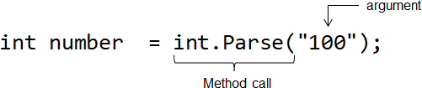
Value-Returning Methods
A value-returning method is a method that returns a value to the part of the program that called it
A value-returning method is like a void method in the following ways:
It contains a group of statements that performs a specific task
When you want to execute the method, you call it
.NET provides many value-returning methods. For example, the int.Parse method accepts a string and returns an int value

Slide 26
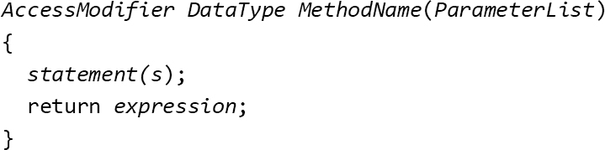
Write Your Own Value-Returning Functions
In
the generic format for writing a value-returning function is:
AccessModifier: private or public
DataType: int, double, decimal, string, bool, etc.
MethodName: the identifier of the method; must be unique in a program
ParameterList: an optional list of parameter
Expression: can be any value, variable, or expression that has a value

Slide 27
The return Statement
There must be a return statement inside the method. It is usually the last statement of the method. This return statement is used to return a value to the statement that called the method. For example:
private int Sum(int num1, int num2)
{
return num1 + num2;
}
Notice that the returned value and the method’s type must match
In the above example, the method is an int method, so it can only return int value

Slide 28
Sample Code
// int type
private int Sum(int num1, int num2)
{
return num1 + num2;
}
// double type
private double Sum(double num1, double num2)
{
return num1 + num2;
}
// decimal type
private decimal Sum(decimal num1, decimal num2)
{
return num1 + num2;
}

Slide 29
Returning Values to Variables
A value-returning method returns a value with specific type. However, the method no longer keeps the value once it is returned.
You can declare a variable to hold the returned value to use the value over and over again
int combinedAge = Sum(userAge, friendAge);
private int Sum(int num1, int num2)
{
return num1 + num2;
}
After execution, the value is kept in the combinedAge variable

Slide 30
Boolean Methods (1 of 2)
A Boolean method returns either true or false. You can use a Boolean method to test a condition
private bool IsEven(int number)
{
bool numberIsEven;
if (number % 2 == 0)
{
numberIsEven = true;
}
else
{
numberIsEven = false;
}
return numberIsEven;
}

Slide 31
Boolean Methods (2 of 2)
With this code, an int value assigned to the number parameter will be evaluated by the if statement
The return statement will return either true or false

Slide 32
Returning a String from a Method
A C# value-returning method can return a string to the statement that called it. For example,
private string FullName(string first, string middle, string last)
{
return first + " " + middle + " " + last;
}
A sample statement to call this method is:
string fullName = FullName("Martina", "Isabella", "Gomez");

Slide 33
Debugging Methods (1 of 4)
The Step Into command allows you to single-step through a called method.
Execute the Step Into command in any of the following ways:
Press the F11 key
Select Debug from the menu bar, and then select Step Into from the Debug menu
Click the Step Into button
on the Debug Toolbar, if
the toolbar is visible
Tutorial 6-6 demonstrates the Step Into command.

Slide 34
Debugging Methods (2 of 4)
The Step Over command allows you to call a method without single-stepping through its statements.
Execute the Step Over command in any of the following ways:
Press the F10 key
Select Debug from the menu bar, and then select Step Over from the Debug menu
Click the Step Over button
on the Debug Toolbar, if
the toolbar is visible
Tutorial 6-7 demonstrates the Step Over command.

Slide 35
Debugging Methods (3 of 4)
When single-stepping through a method, the Step Out command causes the rest of the method's statements to execute without single-stepping.
Execute the Step Out command in any of the following ways:
Press the Shift + F11 keys
Select Debug from the menu bar, and then select Step Out from the Debug menu
Click the Step Out button
on the Debug Toolbar, if the
toolbar is visible
Tutorial 6-8 demonstrates the Step Out command.

Slide 36
Debugging Methods (4 of 4)
Visual Studio can be configured in different ways.
Under some configurations, the Step Into command from the Debug menu might be activated by the F8 function key.
Under some configurations, the Step Over command may be activated by the Shift + F8 keys.
Under some configurations, the Step Out command might be activated by the Ctrl + Shift + F8 keys.
To find out which keys are used, look carefully at these commands when you click on the Debug menu.

